Slide 1
SQL Project –
E-commerce Sales Analysis

Slide 2

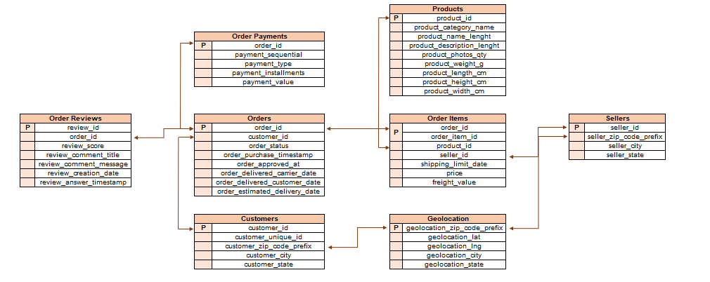
DATA OVERVIEW

Slide 3
Introduction
To analyse a Brazilian E-commerce store and understand how their sales trend across different states over the years
Three years 2016-2018 have been provided for the analysis
In 2016, customers across 21 states used the ecommerce store which increased to 27 states by the year 2017
There are many sellers who sell their products across different states.
Most of the product prices include shipping charges

Slide 4
Analysis
First we create different metrics like orders placed and customer acquisition to understand the trends across the years for different states.
We identified the top 2 states with increasing and decreasing trends
The states with increasing trend were RJ and SP
The states with decreasing trend were RO and AC
To understand the reason behind the following trends we analysed the reviews received, category level sales and delay percentage for shipping as well as delivery.
We further identify the cities that contribute the most in setting up the trends for the states mentioned

Slide 5
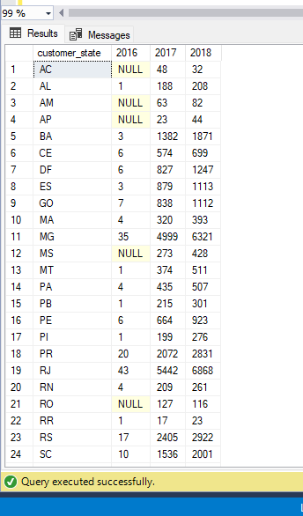
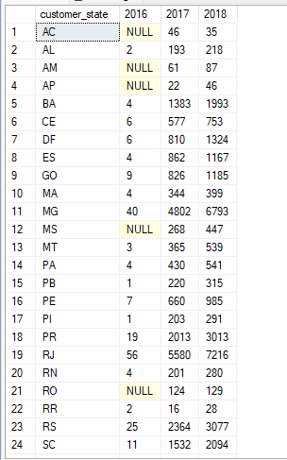
Analysis of different metrics
Order trend
Customer acquisition

Slide 6
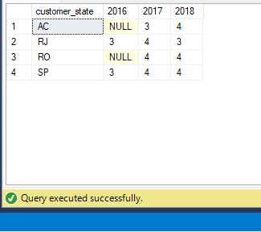
The average reviews received from the 4 states across the years

Slide 7
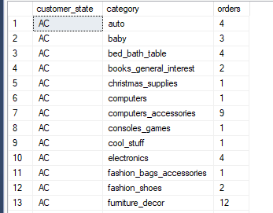
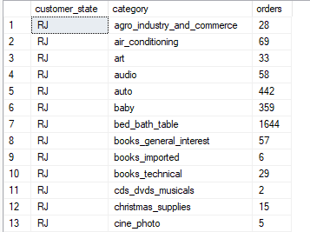
Category level orders placed
AC
RJ

Slide 8
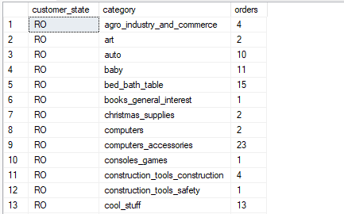
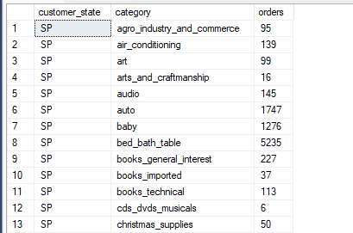
Category level order placed
RO
SP

Slide 9
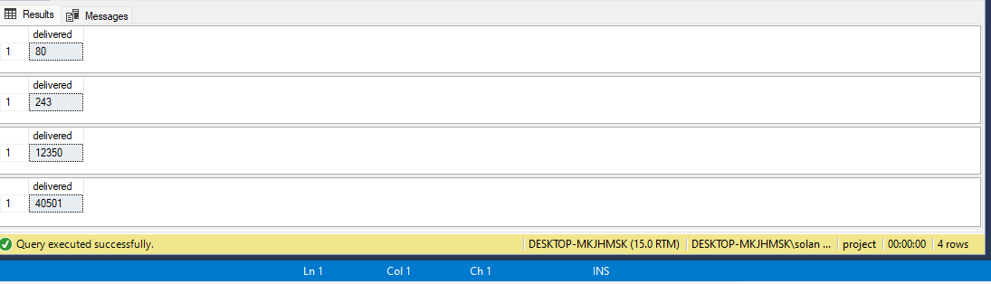
Analysis for orders delivered for the 4 states

Slide 10
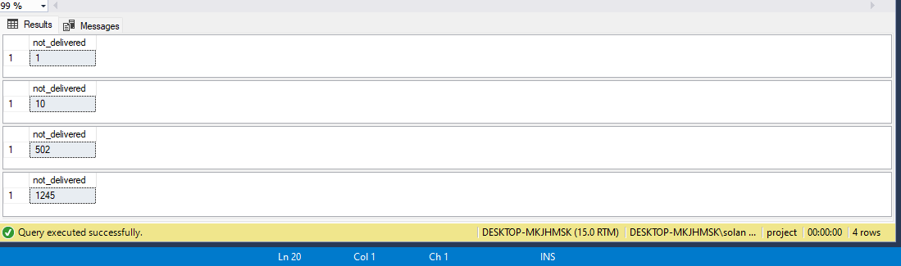
Analysis for orders not delivered for the 4 states

Slide 11
Cities
After analysing the root caused for the trends in the following states, we identify the top cities setting up the trends.
We see that No Branco is the city that sets the trend for AC in terms of maximum number of orders and also delayed orders
Porto Velho sets the trend for AC in terms of max number of orders and delayed orders
We see that rio de janeiro is the city that sets the trend for RJ in terms of maximum number of orders and also delayed orders
Sao Paulo sets the trend for AC in terms of max number of orders and delayed orders

Slide 12
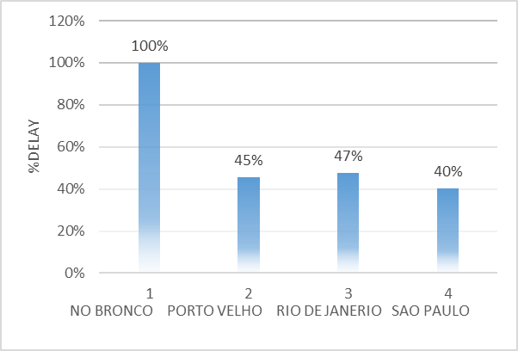
Percentage of delayed orders in cities over the states

Slide 13
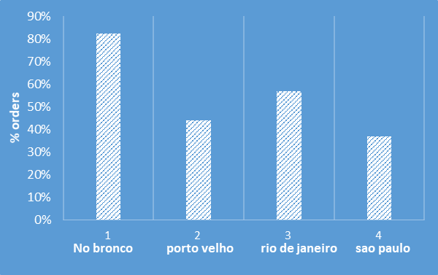
Percentage of orders made by cities out of all the cities in the state

Slide 14
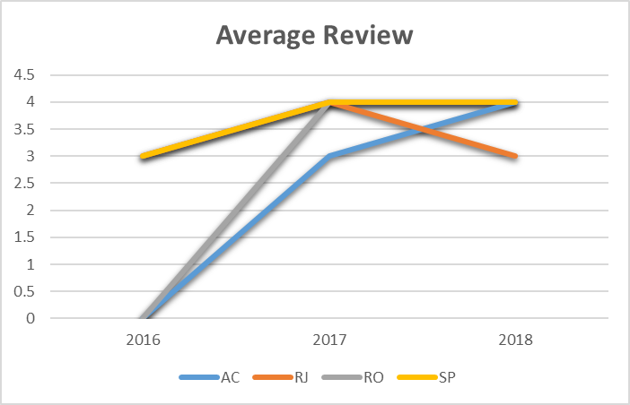

Slide 15
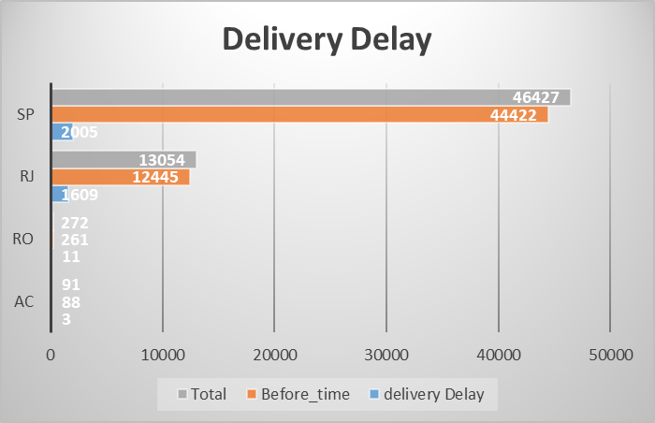
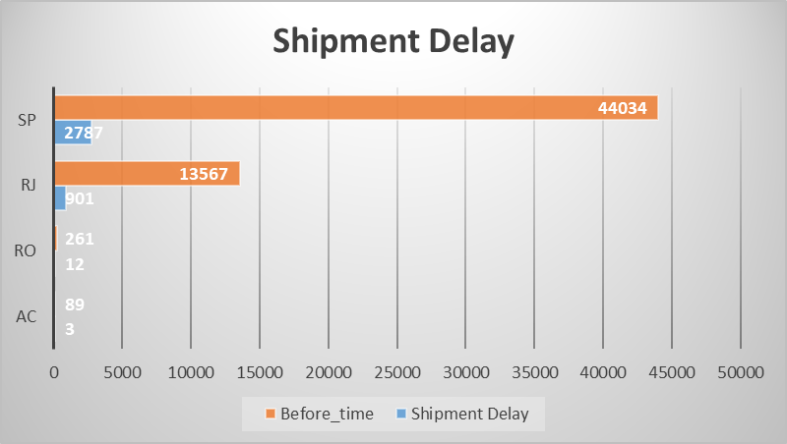

Slide 16
THANK YOU

